Slide 1

KUWAITI STUDENTS LIVING COST analysis

Slide 2

Study Introduction
The goal of this study is to explore and analyze the living cost of Kuwaiti students in the USA over 4 states California CA ,Colorado CO, Arizona AZ, and Oregon OR.
The 4 states were selected according to our students’ density on these states.
We selected the top two cities from each state which includes most of our students (top cities mean these cities have large number of Kuwaiti students who are studying and living there), such as LA and San Diego from California , Denver and Boulder from Colorado, Portland and Corvallis from Oregon, and Tempe & Tucson from Arizona.
We used several techniques to conclude our results as follow:
Comparing two cities’ Mean/AVG from each state regards the following factors: AVG Rent Cost, AVG Utility cost, AVG Transportations Cost, AVG Food cost, and the AVG Extra money requested by students from their families monthly.
Comparing two categories in one city such as (own car/not own car) is one of our strategies in this study.
Comparing one category in two cities on the same state such (AVG rent cost).

Slide 3
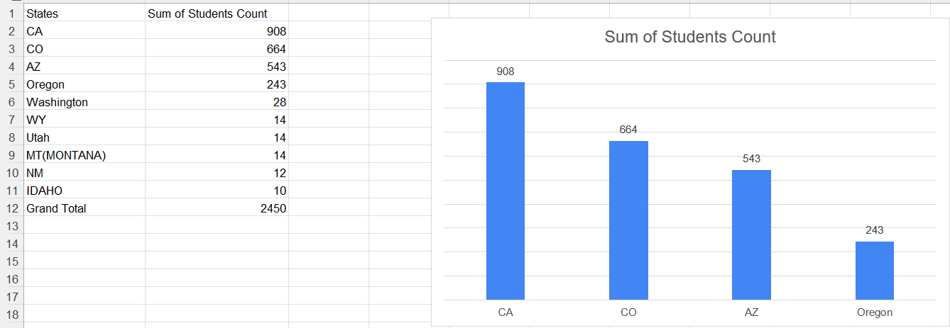

Slide 4
Number of students responded to survey(Top 4 states)

Slide 5
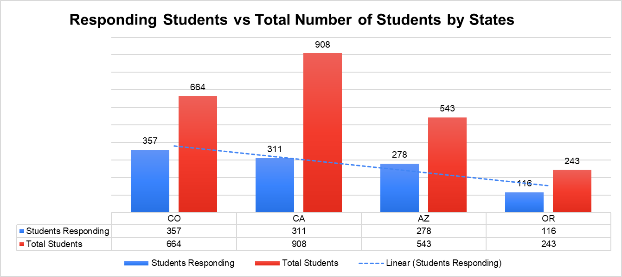
Columns charts
Is about 53.77% of our students in CO were responding in this survey Is about 34.25%% of our students in CA were responding in this survey Is about 51.20% of our students in AZ were responding in this survey Is about 47.74% of our students in OR were responding in this survey The total percentage is 45.46% of the total.

Slide 6

RENT cost paid by Kuwaiti students IN 4 states co, ca, AZ, or.

Slide 7
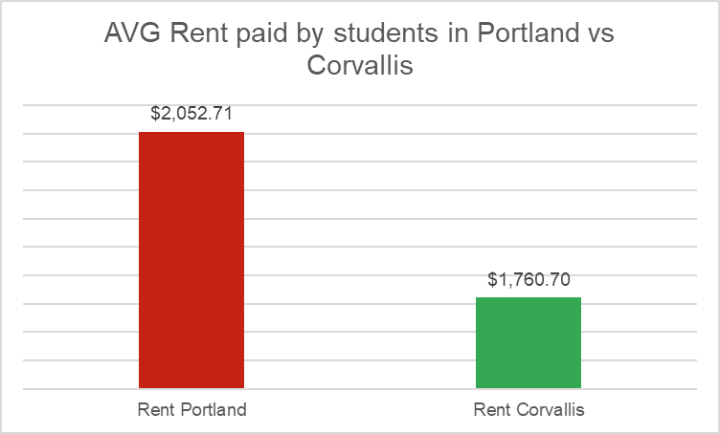
Rent cost paid by students in Portland VS Corvallis in Oregon
Results outlines: The students in Portland are paying more for the rent than students are in Corvallis. The difference between the means is about $$292/per monthly. The minimum paid by Portland students for rent is $850, the maximum is $5600/per month, while the minimum paid by students living in Corvallis is about $670 and the maximum is $4500/per month. NO. OF PARTCIPAINTS : 108

Slide 8
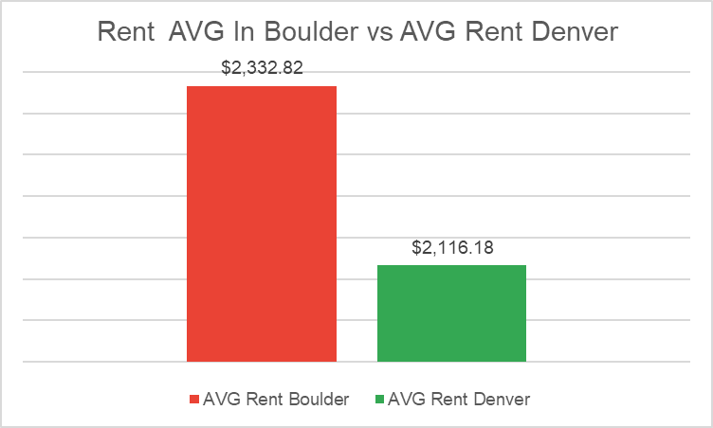
Rent cost paid by students in BOULDER Vs DENVER IN Colorado
Results outline: The students in Boulder are paying more for the rent than students are in Denver. The difference between the means is about $$217/per monthly. The minimum paid by Boulder students for rent is $900, and the maximum is $6000/monthly, while the minimum paid by students living in Corvallis is about $760 and the maximum is $5000/per monthly. NO. OF PARTCIPAINTS : 255

Slide 9
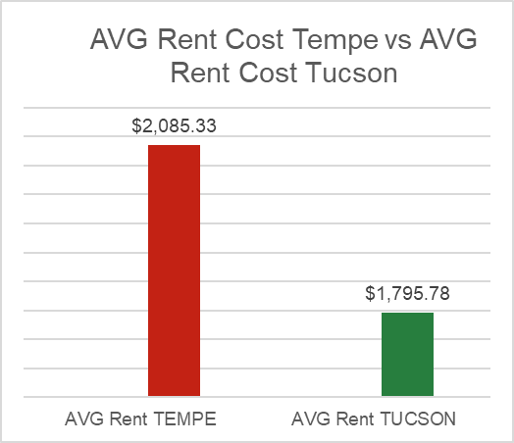
AVG Rent cost paid by students IN TEMPE vs Tucson IN Arizona
Results outlines: The students in Tempe are paying more for the rent than students are in Tuscan. The difference between the means is about $289/per monthly. The minimum paid by Tempe students for rent is $400, and the maximum is $4435/month, while the minimum paid by students living in Tuscan is about $600 and the maximum is $4500/per monthly. NO. OF PARTCIPAINTS :266

Slide 10
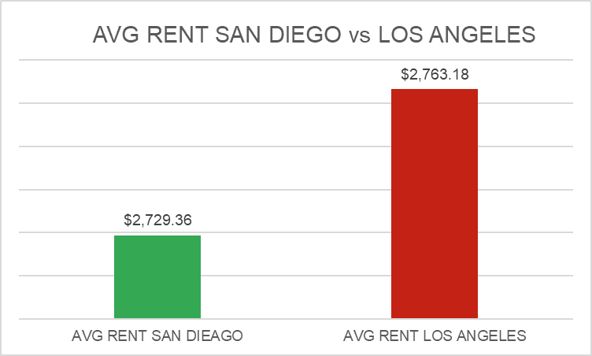
AVG Rent cost paid by students in san Diego vs LOS ANGELES
Results outline: The students in LOS ANGELES are paying more for the rent than students in San Diego. The difference between the means is about $33/month. The minimum paid by Los Angeles students for rent is $390/monthly, and the maximum is $6000/month, while the minimum paid by students living in San Diego is about $925 and the maximum is $6000/per monthly. NO. OF PARTCIPAINTS : 215

Slide 11
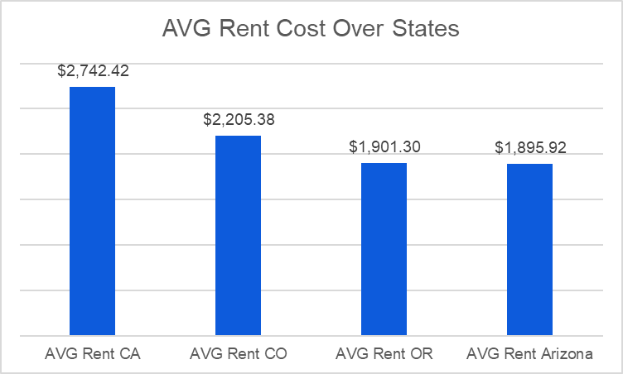
AVG Rent cost over the 4 states ca, co, or az.
According to the table below we can notice that the most expensive state in rent is California, the Avg rent is about $2742/month, and the cheapest state regards rent according to the survey result is Arizona $1895 monthly.

Slide 12
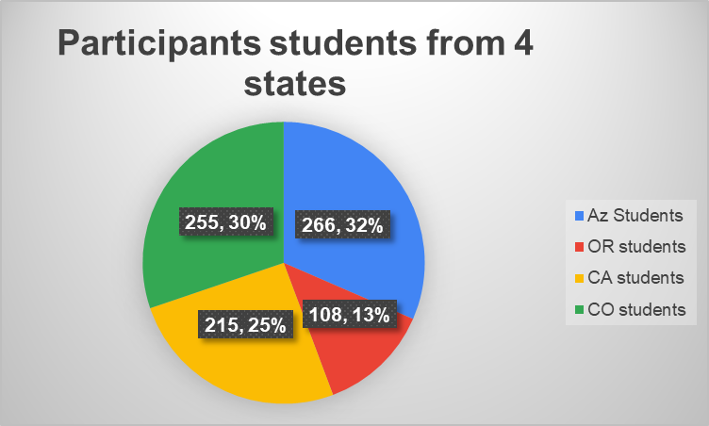
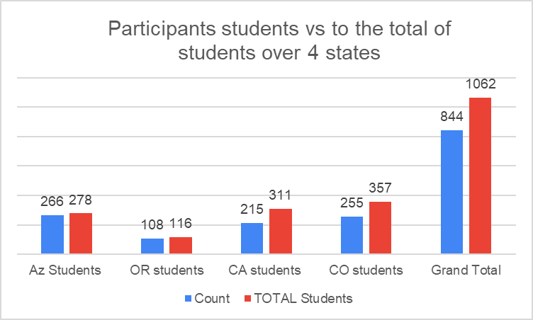
No. of Participants to answer rent question compared to total
There are 844 students from total students 1062 who answered the rent question from the 4 states including AZ, OR, and CA. The percentages are on the chart below.

Slide 13

Transportations COST OWN CARS/NO Personal cars

Slide 14
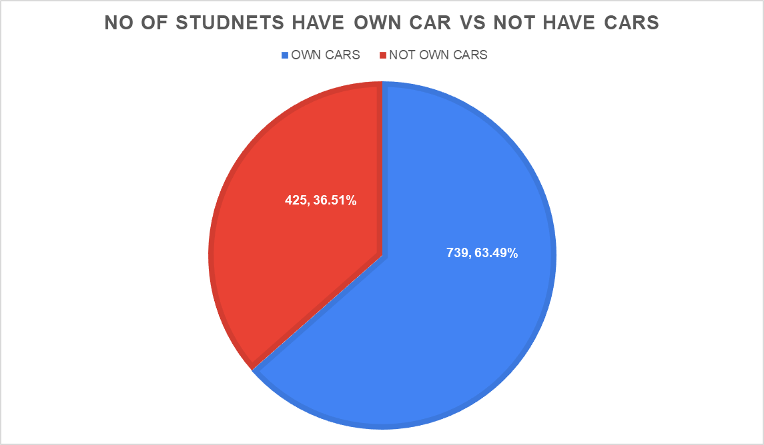
Transportations own cars /not own cars over all the states
The number of students who have their own cars and participated in this survey is 739 students and about 425 students are not have their own cars. The total number of students are answered this question is about 1164 students.

Slide 15
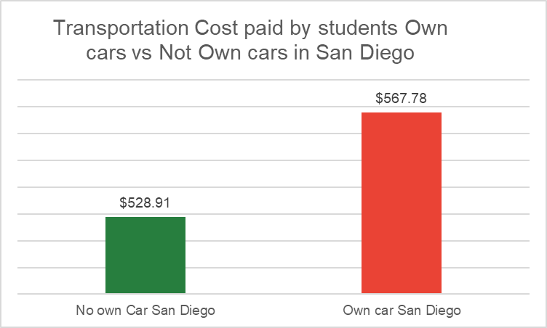
Transportation cost paid by students' own cars vs students don’t own cars in san Diego
Results outlines: The students are own their cars in San Diego are paying more for transportation than students are not own cars in San Diego. The difference between the means is about $39/per month. The minimum paid by students who own their cars for transportation cost $250/per month, and the maximum is $1000/per month, while the minimum paid by students who are not own a car in San Diego is about $100 and the maximum is $1000/monthly. NO. OF PARTCIPAINTS : 129

Slide 16
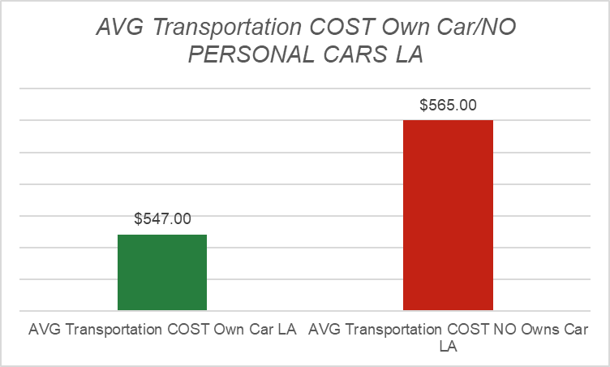
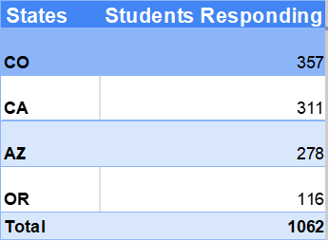
Transportation cost paid by students' own cars vs students don’t own cars in LA, California
Results outlines: The students are own their cars in LA are paying more for transportation than students are not own cars in LA. The difference between the means is about $18/per month. The minimum paid by students who own their cars for transportation cost $100/month, and the maximum is $1000/month, while the minimum paid by students who are not own a car in LA is about $100, and the maximum is $1000/per monthly. NO. OF PARTCIPAINTS : 80
Total CA responding: =129+80=209

Slide 17
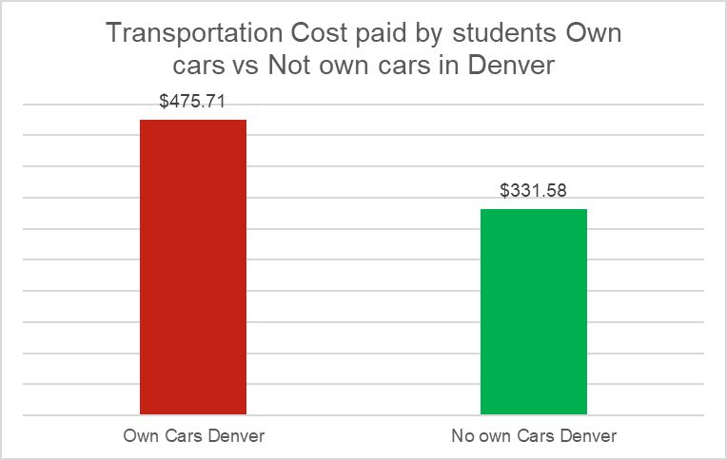
Transportation cost paid by students' own cars vs students don’t own cars in Denver co
Results outlines: The students are own their cars in Denver are paying more for transportation than students are not own cars in Denver. The differences between the means are about $39/month. The minimum paid by students who own their cars for transportation cost $150/month, and the maximum is $1000/per month, while the minimum paid by students who are not own a car in Denver is about $100 and the maximum is $1000/per monthly. NO. OF PARTCIPAINTS : 147

Slide 18
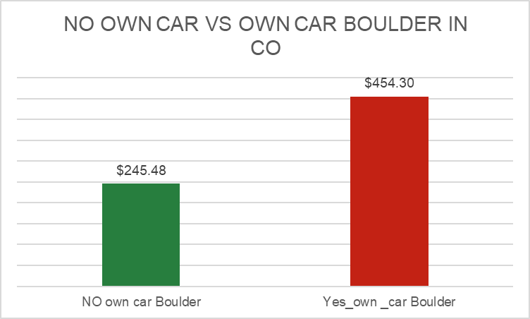
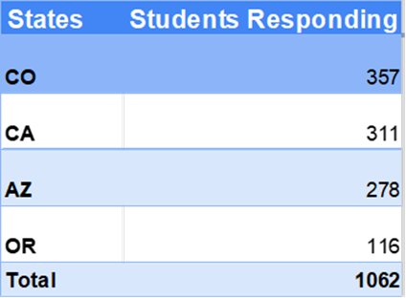
Transportation cost paid by students' own cars vs students don’t own cars in BOULDER, CO
Results outlines: The students are own their cars in Boulder are paying more for transportation than students are not own cars in Boulder. The difference between the means is about $209/per month. The minimum paid by students who own their cars for transportation cost $100/month, and the maximum is $1000/month, while the minimum paid by students who are not own a car in BOULDER is about $150, and the maximum is $1000/per monthly. NO. OF PARTCIPAINTS : 107
Total CO responding :
107+147=254

Slide 19
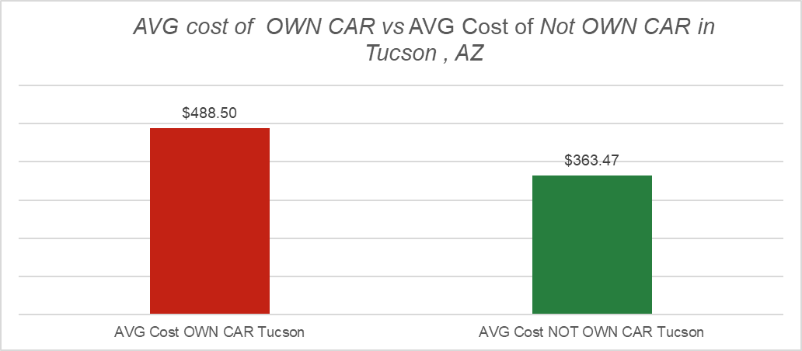

Transportation cost paid by students' own cars vs students don’t own cars in TUCSON,AZ
Results outlines: The students are own their cars in Tucson are paying more for transportation than students are not own cars in Tucson. The difference between the means is about $125.03/per month. The minimum paid by students who own their cars for transportation cost $150/month, and the maximum is $1000/month, while the minimum paid by students who are not own a car in Tucson is about $100, and the maximum is $1000/per monthly. NO. OF PARTCIPAINTS : 174

Slide 20
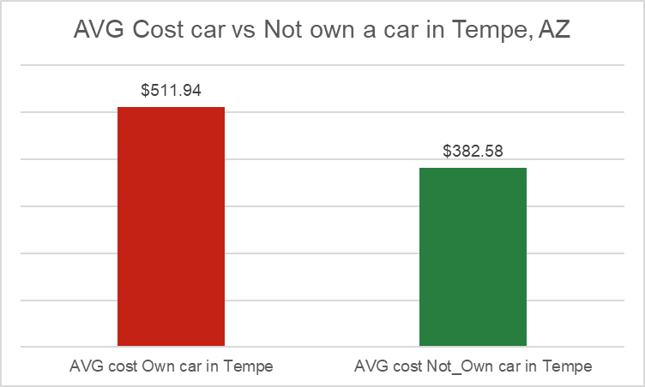

Transportation cost paid by students' own cars vs students don’t own cars IN TEMPE,AZ
Results outlines: The students are own their cars in Tempe are paying more for transportation than students are not own cars in Tempe. The difference between the means is about $129.63/per month. The minimum paid by students who own their cars for transportation cost $100/month, and the maximum is $950/month, as well the minimum paid by students who are not own a car in Tempe is about $100, and the maximum is $1000/per monthly. NO. OF PARTCIPAINTS : 92
Total AZ responding: =174+92=266

Slide 21
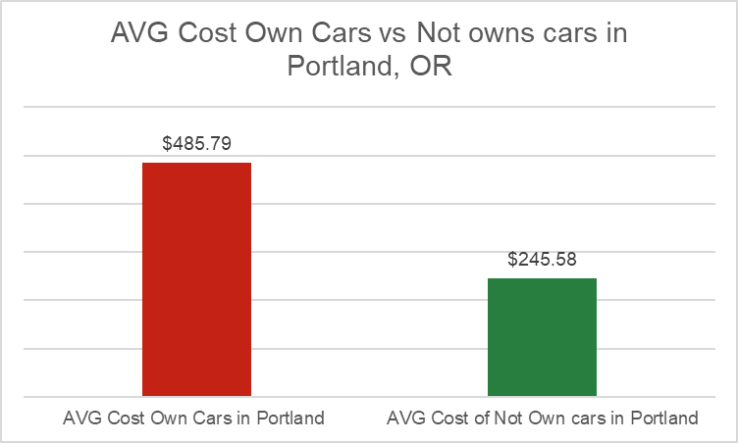

Transportation cost paid by students' own cars vs students don’t own cars in Portland, or
Results outlines: The students are own their cars in Portland are paying more for transportation than students are not own cars in Portland. The difference between the means is about $ 40.21 /per month. The minimum paid by students who own their cars for transportation cost $250/month, and the maximum is $950/month, as well the minimum paid by students who are not own a car in Tempe is about $100, and the maximum is $650/per monthly. NO. OF PARTCIPAINTS is 49

Slide 22
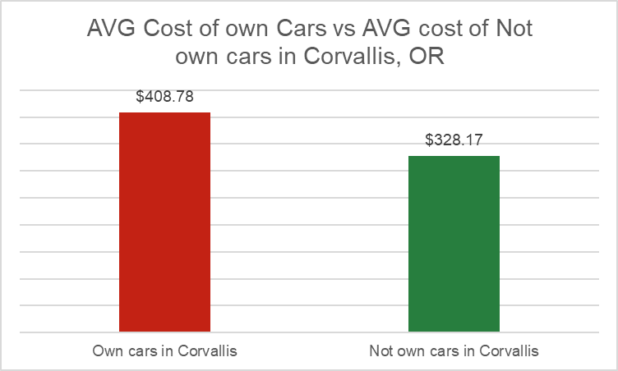

Transportation cost paid by students' own cars vs students don’t own cars in Corvallis, or
Results outlines: The students are own their cars in Corvallis are paying more for transportation than students are not own cars in Corvallis. The difference between the means is about $80.61/per month. The minimum paid by students who own their cars for transportation cost $150/month, and the maximum is $1000/month, while the minimum paid by students who are not own a car in Tempe is about $100, and the maximum is $850,50/per monthly. NO. OF PARTCIPAINTS is 57
Total OR responding: =57+49=106

Slide 23
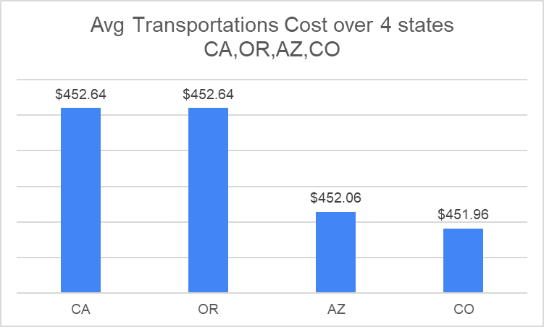
AVG Transportations cost over the 4 states ca, co, or az.
The AVG COST OF transportation regardless of OWN CAR /NOT owning a car is equal for CA, OR, and small difference in AVG cost in AZ, while transportation in CO is cheaper than others.
The total number of students who answered the transportation question is 673 students from the 1062 students.

Slide 24

EXTRA MONEY RECEIVED BY STUDENTS IN THE 4 STATES SORTING BY CITIES.

Slide 25
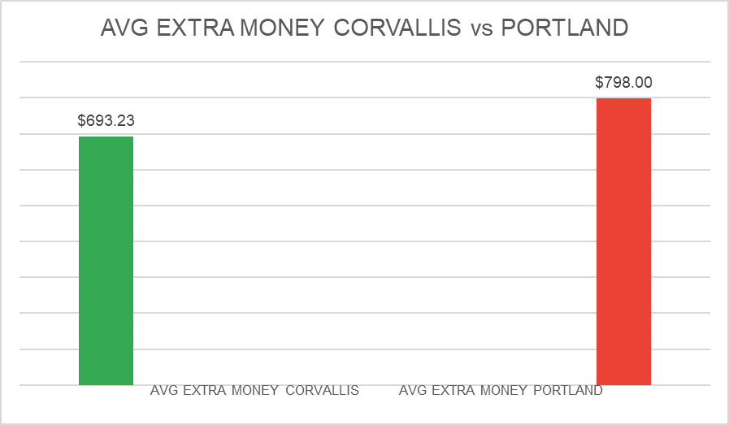
Extra money received by students From their families in Corvallis/Portland in OR
Results Outlines: The students in Portland have received more money from their families than students in Corvallis. The difference between them is about $105/per monthly. The minimum received by Corvallis students is $250 and the maximum is $1000. while the minimum received by students living in Portland is about 375$ and the maximum is $1000. NO. OF PARTCIPAINTS :77

Slide 26
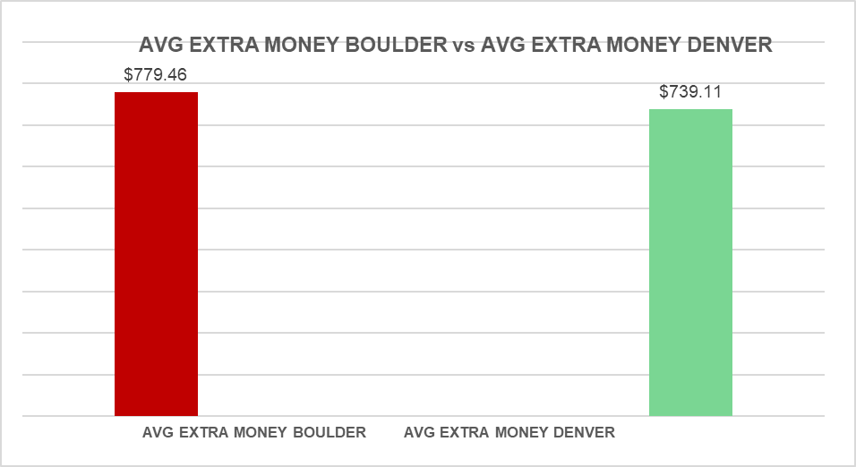
Extra money received by students living in boulder vs Denver, co
Results outlines: The students in Boulder are received more money from their families than students in Denver. The difference between them is about $40/month. The minimum received by Boulder students is $250 and the maximum is $2400/per month. While the minimum received by students living in Denver is about 150$ and the maximum is $1500/per month. NO. OF PARTCIPAINTS : 200

Slide 27
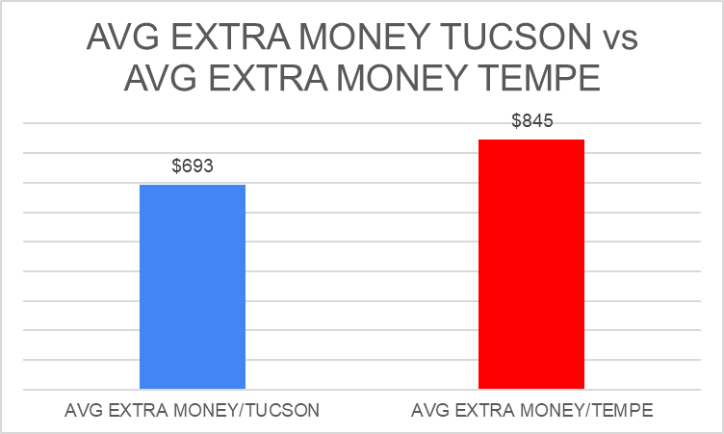
Extra money received by students living in Tucson vs Tempe, AZ
Results outlines: The students in Tempe are received more money from their families than students in Tuscan. The difference between them is about $153/per monthly. The minimum received by Tempe students is $250 and the maximum is $3500/per month. While the minimum received by students living in Tuscan is about 250$ and the maximum is $1750/month. NO. OF PARTCIPAINTS : 214

Slide 28
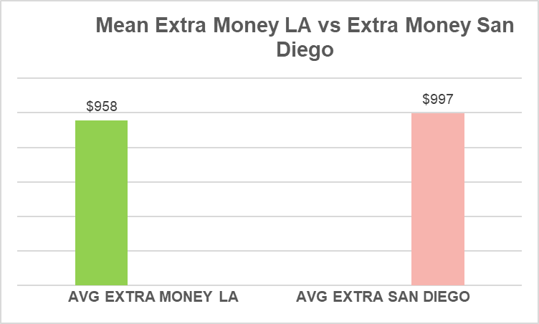
Extra money received by students From their families in LA vs San Diego in California
Results outlines: The students in San Diego are received more money from their family than students are in LA. The differences between the means is about $40/monthly. Minimum received by San Diego students is $250 and maximum is $4800/monthly, while the minimum received by students living in LA is about 375$ and maximum is $4000/monthly. NO. OF PARTCIPAINTS : 191

Slide 29
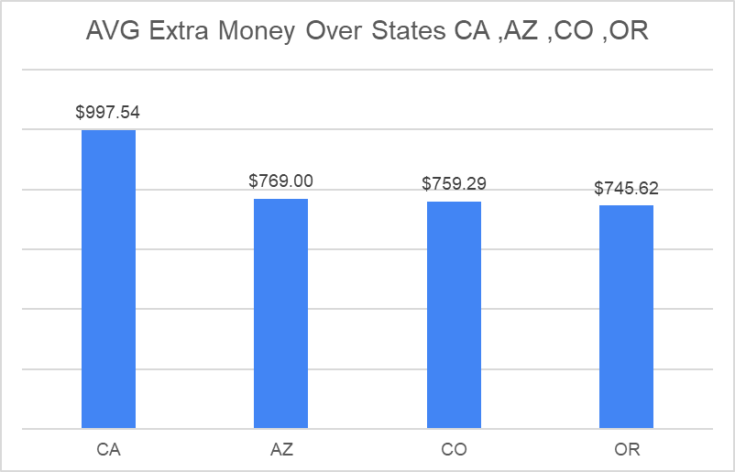
AVG Extra money received by students From their families over the 4 states ca, AZ, CO,OR.
Its clear that CA has the higher AVG Extra money requested by our students from their families and is about $997/monthly. From other side, OR state has the lower AVG extra money requested by Kuwaiti students from their families monthly and is about $745/monthly as shown below
Total students answered the Extra Money question is 682 students from the total 1062 students.

Slide 30
Utilities cost paid by students IN THE 4 STATES co, ca, AZ, or COMPARING two cities/state.

Slide 31
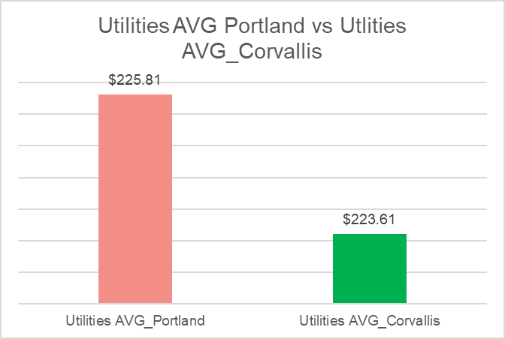
Utilities cost paid by students in Portland vs Corvallis in Oregon
Results outlines: The students in Portland are paying more for the utilities than students are in Corvallis. The difference between the means is about $2 /month. The minimum paid by Portland students is $100 and the maximum is $350/month, while the minimum paid by students living in Corvallis is about 50$ and the maximum is $350/month. NO. OF PARTCIPAINTS :108

Slide 32
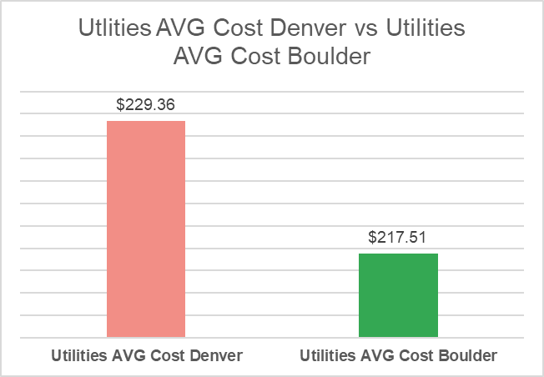

Utilities cost paid by students in Denver vs utilities AVG COST BOULDER IN COLORADO
Results outlines: The students in Denver are paying more for the utilities than students are in Boulder. The difference between the means is about $12 /month. The minimum paid by Denver students is $100 and the maximum is $350/month, while the minimum paid by students living in Boulder is about 50$ and the maximum is $350/month. NO. OF PARTCIPAINTS : 255

Slide 33
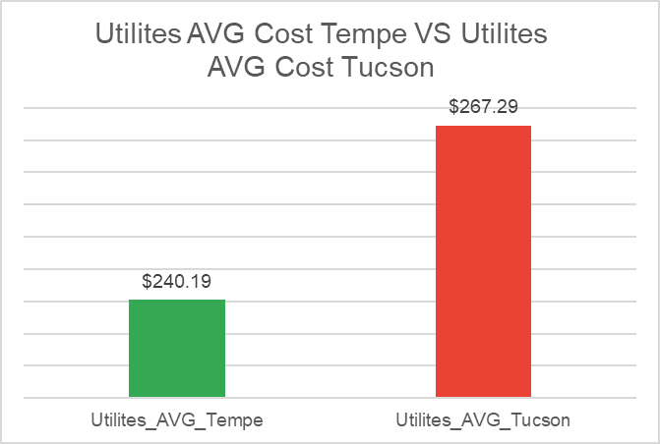
Utilities cost paid by students in Tempe VS Tucson in Arizona
Results outlines: The students in Tuscan r are paying more for the utilities than students are in Tempe. The difference between the means is about $27 /per month. The minimum paid by Tempe students is $125 and the maximum is $350/monthly, while the minimum paid by students living in Tucson is about 0$ and the maximum is $350/monthly. NO. OF PARTCIPAINTS : 227

Slide 34
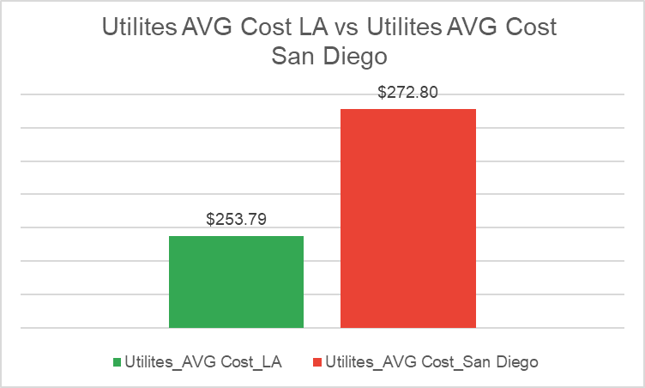
Utilities cost paid by students live in LA vs SAN DIEGO CALIFORNIA
Results outlines: The students in San Diego are paying more for the utilities than students are in LA. The difference between the means is about $19/per monthly. The minimum paid by LA students is $125, and the maximum is $350/per monthly, as well as the minimum paid by students living in San Diego is about $125 and the maximum is $350/per monthly. NO. OF PARTCIPAINTS : 212
Total students answered the Utilities question is 802 students from the 1062 students.

Slide 35
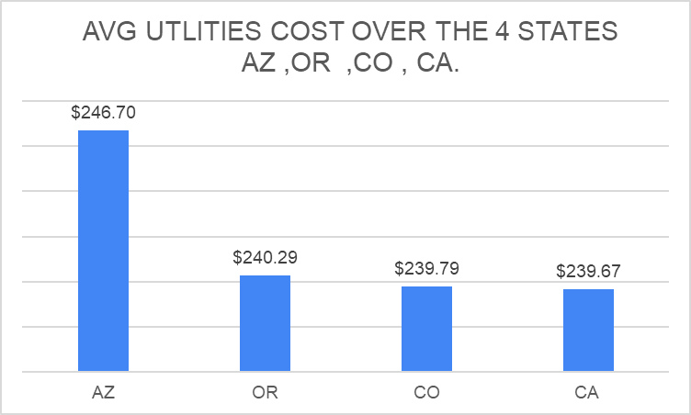
AVG utilities cost over the 4 states ca, co, or az.
The most expensive states from the utilities cost is AZ and the cheapest one is CO and CA.

Slide 36

AVG FOOD cost paid by students sorting by cities

Slide 37
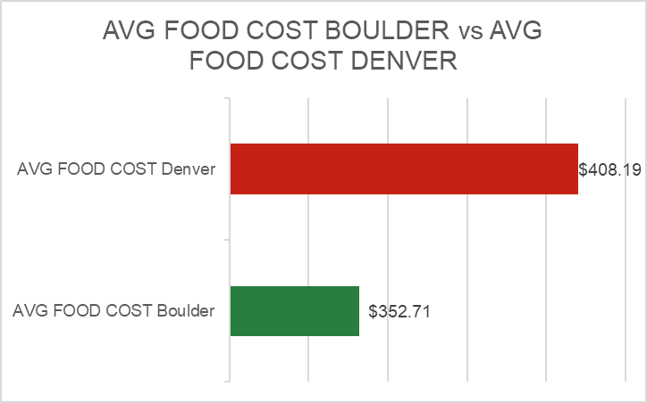
AVG FOOD cost paid by students in boulder VS DENVER, COLORADO
Results outlines: The students in Denver are paying more for the food than students are in Boulder. The difference between the means is about $55/per month. The minimum paid by Denver students for food is $50/monthly, and the maximum is $950/per month, while the minimum paid by students living in Boulder is about $50 and the maximum is $950/per month. NO. OF PARTCIPAINTS : 255

Slide 38
AVG FOOD cost paid by students in San Diego vs Los Angeles in California
Results outlines: The students in San Diego are paying more for the food than students are in LA. The difference between the means is about $18/per monthly. The minimum paid by San Diego students for food is $50/monthly, the maximum is $1000/per month, while the minimum paid by students living in LA is about $0 and the maximum is $950/per monthly. NO. OF PARTCIPAINTS :148

Slide 39
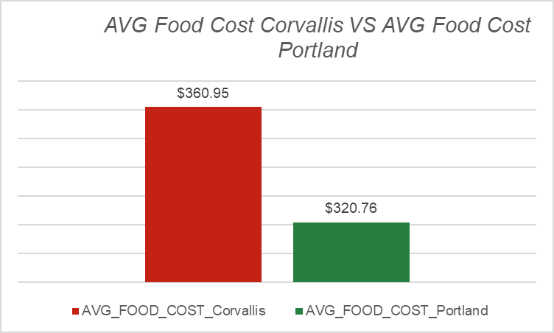
AVG FOOD cost paid by students in Portland vs Corvallis in Oregon
Results outlines: The students in Corvallis are paying more for the food than students are in Portland. The difference between the means is about $40/per month. The minimum paid by Portland students for food is $50/per month, the maximum is $950/per month, while the minimum paid by students living in Corvallis is about $50 and the maximum is $ 850 monthly. NO. OF PARTCIPAINTS : 106

Slide 40
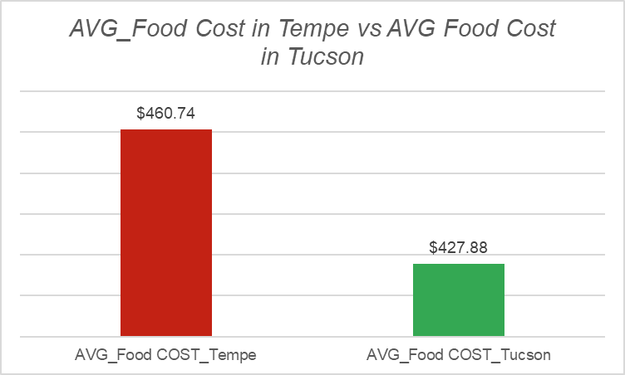
AVG FOOD cost paid by students in TEMPE VS IN Tucson IN ARIZONA
Results outlines: The students in Tempe are paying more for the food than students are in Tucson. The differences between the means are about $33/per monthly. The minimum paid by Tempe students for food is $50/monthly, and the maximum is $950/monthly, while the minimum paid by students living in Tuscan is about $50 and the maximum is $1000/monthly. NO. OF PARTCIPAINTS : 265
Total students answered the food cost question is 774 students from the 1062 students.

Slide 41
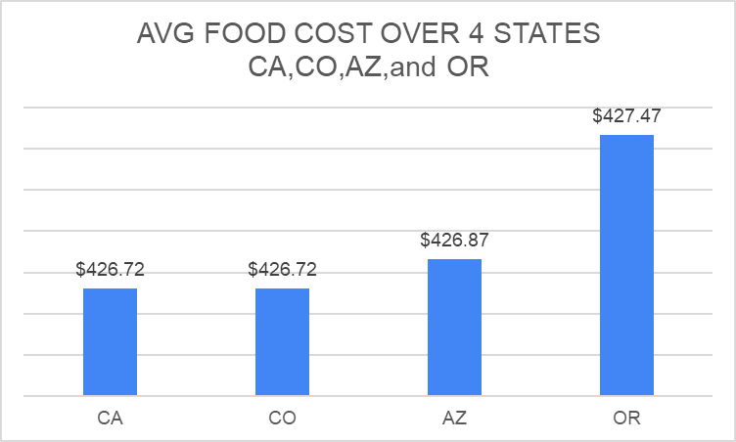
AVG FOOD cost paid by students over 4 states CA, CO,AZ, and OR.
The AVG cost of food over 4 states is approximately similar despite the AVG cost of food in OR being more than other states and is about $427.47/ monthly.

Slide 42

conclusion

Slide 43
Conclusion
The most expensive state in rent is California, the Avg rent is about $2742/month, and the cheapest rent state according to the survey result is Arizona $1895 monthly.
The AVG COST OF transportation regardless of OWN CAR /NOT owning a car is approximately equal for CA, OR, and AZ ($452), while transportation in CO (451) is cheaper comparing to other states
The AVG cost of food over 4 states is approximately the same and OR is the higher Avg cost and is about $427/ monthly.
The most expensive states utilities is AZ (AVG cost is $246/monthly)and the cheapest one is CO and CA(AVG cost $239/monthly).
The higher AVG Extra money requested by our students from their families is in CA, and it is about $997/monthly. From other side, OR state has the lower AVG extra money requested by Kuwaiti students from their families monthly and is about $745/monthly

Slide 44

Thank you !
QUSTIONS?

